Slide 1
Gen-AI Powered Data Profiling and Validation System
Automated Compliance Checking for Financial Data
Team: Hakuna Matata
Anshoo Rajput Parva Patel
Neel Thakker
Mona Gupta
March 26, 2025

Slide 2
System Overview

Slide 3
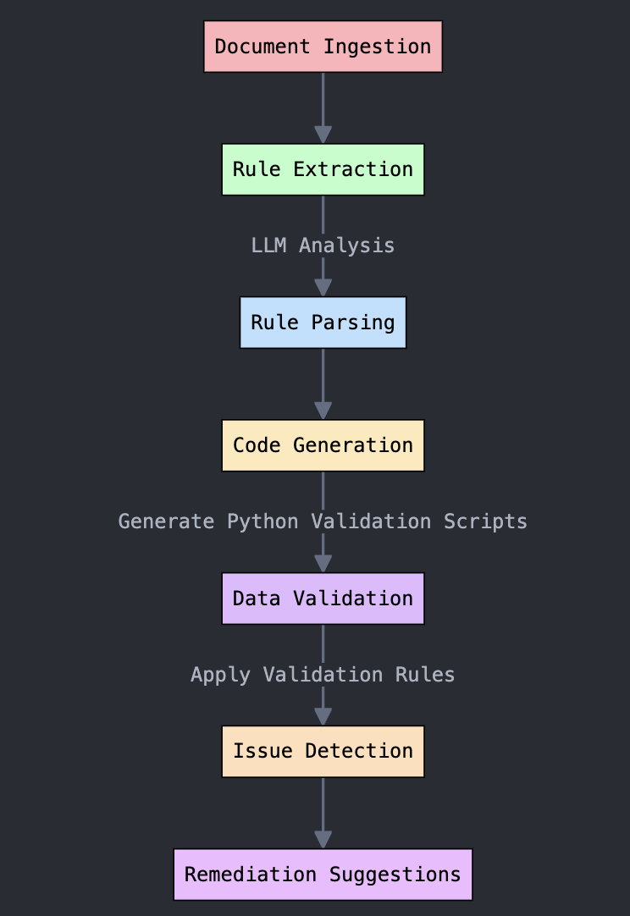
Architectural Diagram:
Key Components:
Mistral-7B LLM
Advanced AI model for extracting validation rules
Generates precise Python validation code from regulatory documents
Vector Database
Enables semantic search across compliance documents
Supports efficient retrieval and indexing of regulatory information
SQLite Database
Lightweight storage for validation rules and results
Provides reliable local data persistence and querying

Slide 4
Model Selection - Mistral-7B
Performance Advantages
Matches performance of 70B parameter models
Highly efficient computational resource utilization
Open-weight model with commercial usability
Optimized for complex instruction following
Key Selection Criteria
✅ Cost-effectiveness
✅ Performance-to-size ratio
✅ Operational flexibility
Alternatives Comparison
GPT-3.5/4: Superior but prohibitively expensive
Llama 2: Larger versions resource-intensive
Claude: Limited API accessibility

Slide 5
Technical Approach
1) Structured Rule Extraction
Strict JSON output formatting
Multi-level LLM response validation
Ensures precise, consistent rule generation
2) Self-Correcting Code Generation
Enforced function signature constraints
Automated execution testing
Guarantees code reliability and accuracy
3) Flexible Input Modes
File upload (CSV/Excel)
Manual data entry
Supports diverse data input scenarios
4) Concurrency Management
Thread-safe database operations
Implements robust access control
Prevents data conflicts in multi-user environments

Slide 6
AI Solution vs Traditional ETL Systems
Comparative Advantages
Key Impact
🚀 Reduces Rule Implementation Time:
Days → Minutes
Aspect | Traditional ETL | AI-Powered Solution
Rule Creation | Manual Coding | Automated Extraction
Maintenance | High Complexity | Minimal Effort
Adaptability | Weeks to Change | Minutes to Update
Error Handling | Generic Messages | Contextual Remediation
Cost Efficiency | Higher maintenance cost | Lower long-term cost

Slide 7
Implementation Challenges & Solutions
Technical Hurdles
LLM Output Consistency
Multi-stage validation
Regex and schema checks
Code Generation Safety
Sandboxed execution
Strict input/output contracts
Document Variability
Intelligent chunking
Contextual overlap strategies
Operational Constraints
Hugging Face rate limit management
On-premise document processing
Privacy preservation

Slide 8
Future Enhancements & Research
Product Roadmap
Multi-document cross-referencing
Rule versioning with temporal tracking
Cloud data warehouse integration
Domain-specific model fine-tuning
Research Directions
Few-shot learning for rare rule patterns
Automated test case generation
Advanced contextual understanding

Slide 9
Conclusion: AI-Powered Compliance Revolution
Key Takeaways
LLMs transform complex compliance workflows
Structured prompting ensures reliable AI outputs
Proven production-ready accuracy
Impact
🚀 From Manual to Intelligent Automation
📊 Precision at Scale
🔒 Compliance Reimagined

Slide 10
Thank You!

